Slide 1


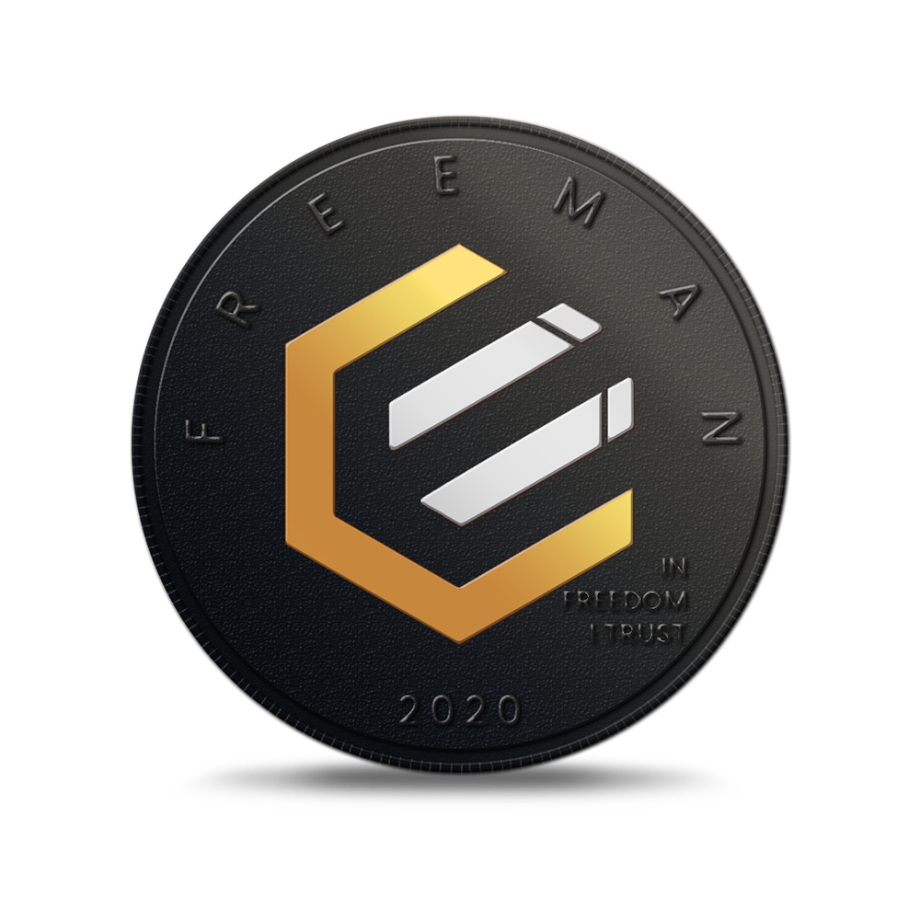

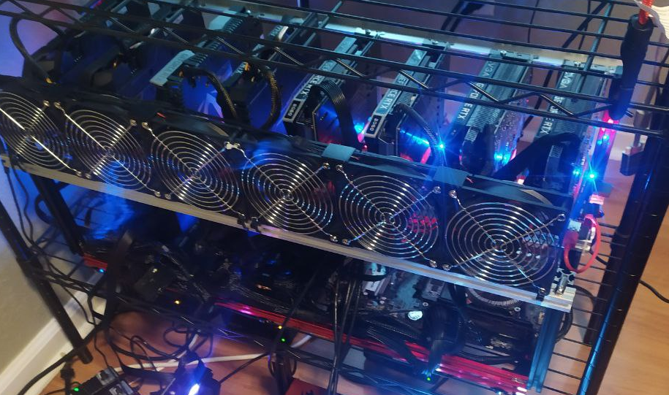
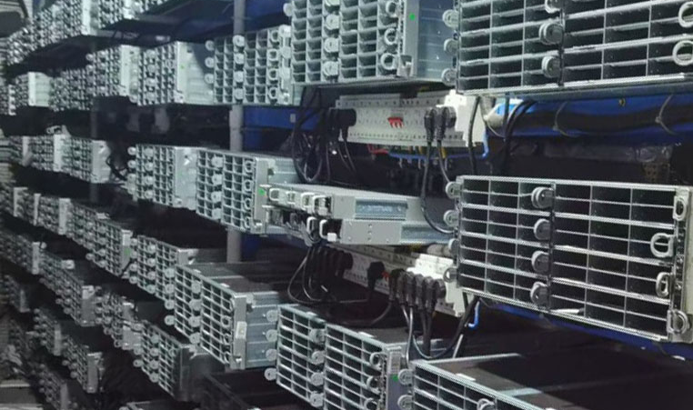


$1
RECEIVE AT LEAST
WORTH OF
Currently 78,125,000 Freeman @ $1.28 EPIC / USD rate as of April 24
HOW DOES IT WORK?
1
User installs the Epic Cash wallet (free, no signup registration)
2
User buys 1 EUSD through eBay, paying by Paypal
3
EUSD is simply a credit for $1 worth of EPIC at the current market rate
4
The miners mine into the customer wallet, giving them the EPIC they want
5
EUSD is used as a bridge between Paypal and EPIC
6
The value of EPIC goes up and down, but 1 EUSD is always 1 EUSD
BENCHMARKS:
RandomX
Intel Xeon E5 8kh/s
AMD 7742 100kh/s
ProgPow
AMD Vega 56 19mh/s
NVIDIA 1080ti 23mh/s
200
100
kh/s RandomX
kh/s RandomX
Norcimo, RandomX Miner
USA, Florida
Satoshi E, RandomX Miner
China
Actual farm photos 24th April 2021
100%
Satisfaction guaranteed or your money back
FinCEN guidance on convertible virtual currency cloud mining regulations in the United States
FinCEN website
eBay terms of service allow for the leasing of cryptocurrency mining equipment
EC210406 - EC Mint v02

